Slide 1
GAUS Seidel
Al-Azhar Rizqi Rifa’I Firdaus
Ichsan Ali Darmawan
Sri Kresna Maha Dewa
Steven Christian Susanto

Slide 2
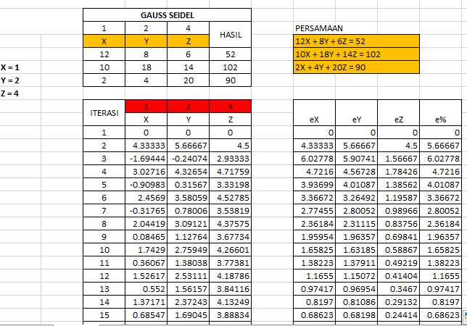
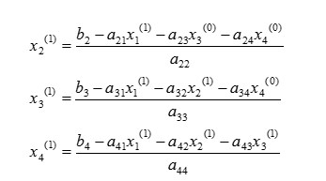
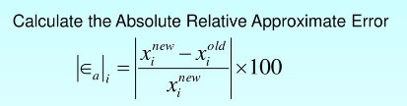
EQUATION

